Slide 1
Microprocessor and Computer Architecture(ELX 301)
BIT 3rd Semester
Er. Suraj Basant Tulachan
Assistant Professor

Slide 2
Unit 10: Parallel Processing
Outline:
  10.1 Parallel Processing.
  10.2 Parallelism in Multiprocessor System.
  10.3 Flynn’s Classification.
  10.4 Interconnection Structure in Multiprocessor System.
  10.5 Vector Arithmetic Unit.
  10.6 Multithreaded Structure.

Slide 3
Unit 10: Parallel Processing
Parallel Processing:-
Parallel processing is a technique that performs the data processing task
simultaneously at a same time.
It increases the conceptual speed of computer system.
The system may have two or more ALUs which will be able to execute two or more instructions at the same time.

Slide 4
Unit 10: Parallel Processing
Parallel Processing:-
The purpose of parallel processing is to speed up the computer processing
capability and increase its Throughput (The amount of task those are completed
during given interval of time).
It is also called parallel computing.

Slide 5
Unit 10: Parallel Processing
Parallelism in Multiprocessor System:-
Parallelism in Multiprocessor System is a concept of computing technique when multiple streams of calculations or data processing tasks co-occur through numerous central processing units (CPUs) working concurrently. Parallelism in Multiprocessor System processing uses two or more processors or CPUs simultaneously to handle various components of a single activity.

Slide 6
Unit 10: Parallel Processing
Flynn’s Classification of Computer:-
There are four groups of computers according to the Flynn’s classification.
It is based on the number of concurrent instruction and data streams processed or manipulated by the computer system.
The normal operation of a computer is to fetch instructions from memory and execute them in processor.

Slide 7
Unit 10: Parallel Processing
Flynn’s Classification of Computer:-
Instruction stream:- The sequence of instructions read from
memory.
Data stream:- The operations performed on the data in the
processor.
Parallel processing may occur in the instruction stream, in the
data stream, or in both.

Slide 8
Unit 10: Parallel Processing
Flynn’s Classification of Computer:-
The Flynn’s classification of computer are:
Single instruction stream, Single data stream (SISD)
Single instruction stream, Multiple data stream (SIMD)
Multiple instruction stream, Single data stream (MISD)
Multiple instruction stream, Multiple data stream (MIMD)

Slide 9
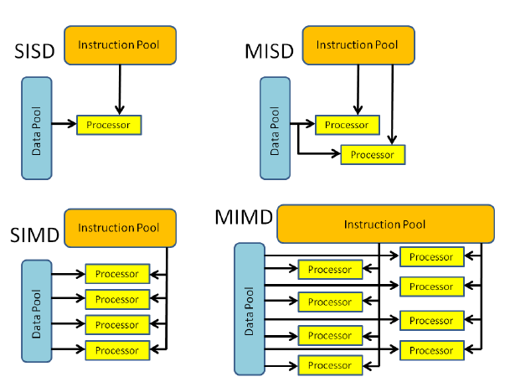
Unit 10: Parallel Processing
Flynn’s Classification of Computer:-

Slide 10
Unit 10: Parallel Processing
Flynn’s Classification of Computer:-
Single Instruction stream, Single data stream (SISD):-
SISD has a processor, a control unit, and a memory unit.
There is a single processor which executes a single instruction stream to operate
on the data stored in a single memory in this system.
The parallel processing in this case may be achieved by means of multiple
functional units or pipeline processing.

Slide 11
Unit 10: Parallel Processing
Flynn’s Classification of Computer:-
Single Instruction stream, Multiple data stream:-
SIMD executes a single machine instruction on different set of data by different
processors.
Each processing element has associated data memory.
All the processor receives the same instruction from control unit but operate on
different items of data.
Application of SIMD is vector and array processing.

Slide 12
Unit 10: Parallel Processing
Flynn’s Classification of Computer:-
Multiple Instruction stream, Single data stream :-
MISD has many functional units which perform different operations on the same
data.
It is a theoretical model of computer.
Multiple Instruction stream, Multiple data stream :-
MIMD consists of a set of processors which simultaneously execute different
instruction sequences on the different set of data.

Slide 13
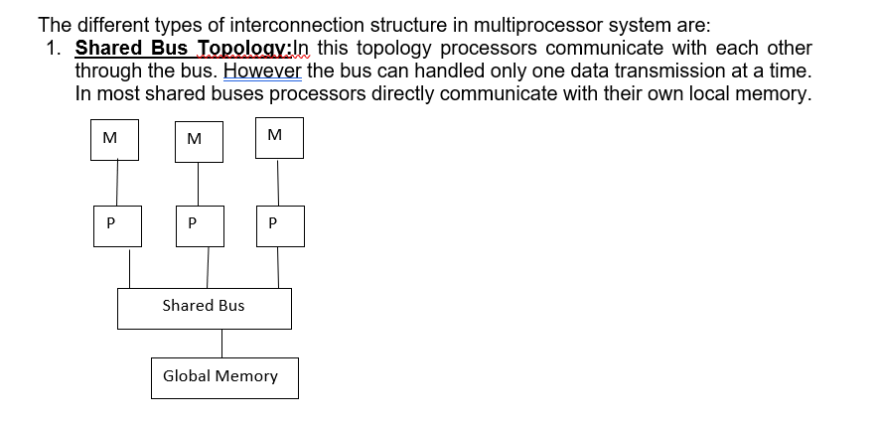
Unit 10: Parallel Processing
Interconnection Structure in Multiprocessor System:-

Slide 14
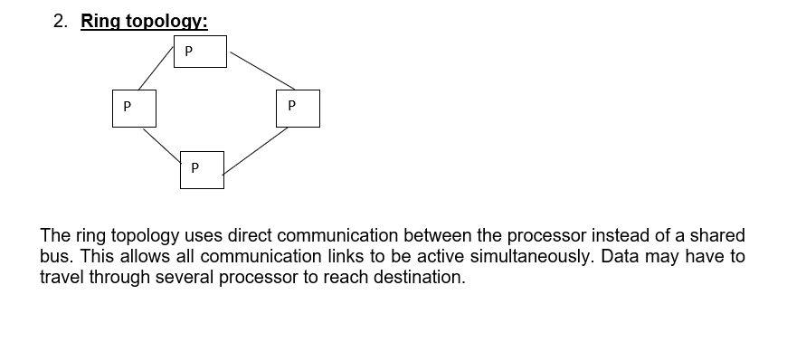
Unit 10: Parallel Processing
Interconnection Structure in Multiprocessor System:-

Slide 15
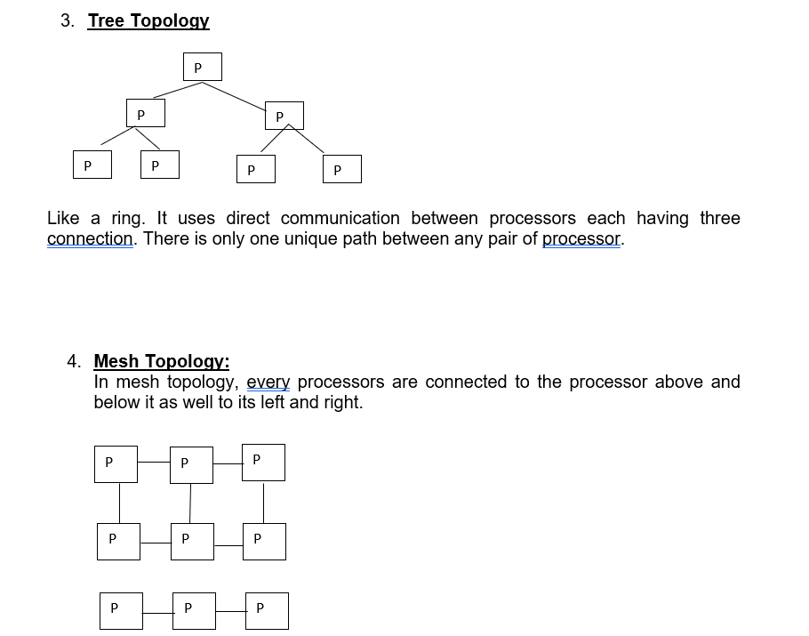
Unit 10: Parallel Processing
Interconnection Structure in Multiprocessor System:-

Slide 16
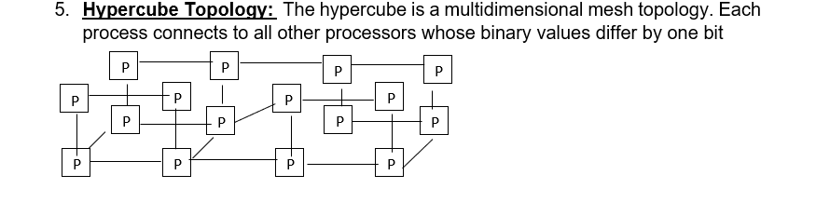
Unit 10: Parallel Processing
Interconnection Structure in Multiprocessor System:-

Slide 17
Unit 10: Parallel Processing
Vector Arithmetic Unit:-
Computational problems are beyond the capabilities of a conventional computer.
Large number of computations will take a conventional computer, days or even weeks to complete.
In many science and engineering applications, the problems can be formulated in terms of vectors and matrices that lend themselves to vector processing.
Computers with vector processing capabilities are in demand in specialized applications.

Slide 18
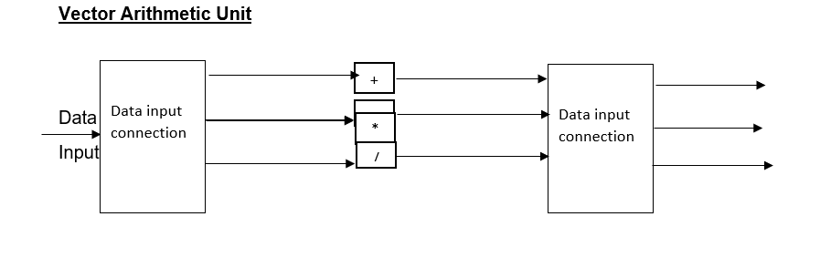
Unit 10: Parallel Processing
Vector Arithmetic Unit:-
Vector arithmetic unit is used to perform different arithmetic operations in parallel. A vector arithmetic unit contains multiple functional units some of the operations are additional subtraction, multiplications etc. to add two numbers the control unit routes these values to an adder unit.

Slide 19
Unit 10: Parallel Processing
Applications of Vector Processors
Computer with vector processing capabilities are in demand in specialized applications. The following are some areas where vector processing is used:
Petroleum exploration.
Medical diagnosis.
Data analysis.
Weather forecasting.
Aerodynamics and space flight simulations.
Image processing.
Artificial intelligence

Slide 20
Unit 10: Parallel Processing
Multithread Structure
Multithread is an ability of a central processing unit or a single core in a multicore processors to execute multiple process or threads concurrently. This approach differs from multiprocessing because in multithreading, the threads have to share the resources of a single or multiple cores. Multithreading aims to increase utilization of a single core by using thread as well as instruction level parallelism.

Slide 21
Unit 10: Parallel Processing
Multithread Structure
Advantages
Utilization of a single resources
Increase in efficiency by utilizing unused computing structure
Disadvantages
Multiple threads can interfere with each other while sharing the resources

Slide 22
THANK YOU

